Slide 1






Protecting the Public and Supporting Business During the Pandemic
The Impacts and Outcomes of Local Trading Standards Services in Wales 2020/21
This report is the first year that Trading Standards Services in Wales have benefitted from Trading Standards Wales’s (TSW) comprehensive assessment into the value that local Trading Standards Services deliver based on the report published by the Association of Chief Trading Standards Officers (ACTSO) that represents Heads of Trading Standards across both England and Wales.
This year’s report, 2020/21, coincidences with the most severe periods of the Covid 19 pandemic and can therefore assess the impact of the Covid 19 specific work carried out by Trading Standards services in addition to the usual three themes of Tackling Detriment and Preventing Harm, Supporting the Local Economy, and Promoting Health and Wellbeing. However, due to the severe impact of Covid 19 on services, the findings of this year’s report will be incomparable to any other.
This document provides a snapshot of the key findings from this year’s assessment and demonstrates Trading Standards’ continued value in focusing support on protecting and supporting the most vulnerable and local businesses through very difficult times.
In 2020/21, despite the COVID-19 pandemic, local Trading Standards Services have:
Prevented over £1 million of detriment
Provided support to 1,000 scam victims and secured £54,000 in redress through advice and intervention
Responded to 3,384 requests for advice from businesses
Received almost 280,000 referrals and notifications to services
Carried out almost 48,000 Covid related visits and inspections to businesses across Wales
TACKLING DETRIMENT AND PREVENTING HARM
One of the key functions of Trading Standards is to prevent consumer and business detriment (financial and non-financial), tackle criminal behaviour that leads to it and support victims.
Key statistics for 2020/21 included:
86 defendants taken through the prosecution process
Over £167,000 prevented
from being handed over to criminals
Prison sentences of 344 months handed down. This included both immediate and suspended sentences
Local authority Trading Standards
provided support to over 1,000 scam victims
Defendants were ordered to pay
over £435,000 in Proceeds of Crime
Work to disrupt mass marketing fraud mailings, stop outgoing payments, mail etc saved consumers over £222,000

Slide 2
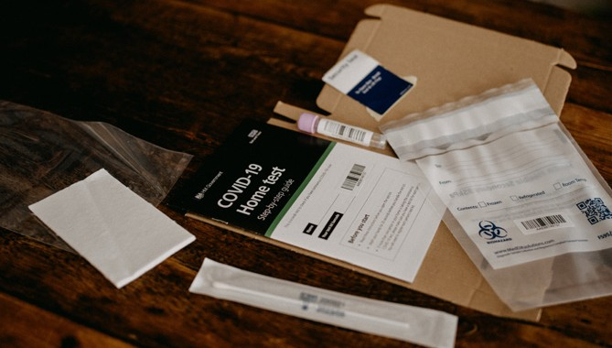
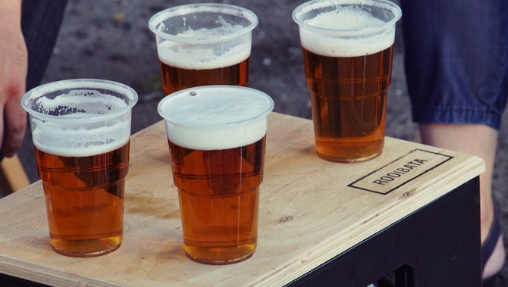













SUPPORTING THE LOCAL ECONOMY
Businesses need advice and support from Trading Standards to help them navigate the range of laws that ensure they trade fairly and safely. This was particularly crucial this year when businesses needed to respond to Covid legislation and change their businesses to survive during the pandemic.
Key statistics for 2020/21 included:
3,384 responses to requests for advice from businesses
Over 2,500 visits were carried out to businesses to ensure they comply with the law and provide advice to help them fix any non-compliance
Over 27,000 counterfeit products were seized with a market value of over £312,000, which breach
the intellectual property of legitimate businesses
Over 750 businesses were subject to an intervention, such as advice, investigation or referral
PROMOTING HEALTH AND WELLBEING
Trading Standards undertake a wide range of activities to protect and promote the health and well-being of local communities. This includes ensuring that products people buy are safe, that food is correctly and clearly labelled to help them to make healthy choices and avoid allergens.
Key statistics for 2020/21 included:
Over 34,000 unsafe or non-compliant products and PPE were seized or removed from the market place following Trading Standards’ interventions
Nearly 1,100 premises were visited to check that the Minimum Unit Pricing for alcohol sales was being observed
The savings to society, in terms of product value and injuries and fires prevented, is almost £1 million
Seizure of illegal tobacco from 48 premises
Over 215 businesses were identified as supplying food that was misdescribed, did not correctly declare
allergens, contained toxic or illegal components or were involved in food fraud
Over 536,000 illicit cigarettes were seized, worth an estimated £120,000
Over 500 businesses were found to be in breach of animal health and welfare legislation
TRADING STANDARDS SUPPORT FOR THE COVID RESPONSE
Trading Standards were a key part of the local authority Covid response, along with other colleagues in regulatory services.
Key statistics for 2020/21 included:
In Wales:
157 incidents of COVID related issues concerning refunds and the return of deposits reported
Supported local authorities with over 42,000 Covid related enquiries
663 Business Improvement Notices were issued as well as 142 Business Closure Notices in order to keep people safe
Carrying out over 48,000 visits to business
237 COVID related scams reported

