Slide 1






Protecting the Public and Supporting Business – The Cost of Living Crisis and local Trading Standards continuing response
The Impacts and Outcomes of Local Trading Standards Services in Wales 2022/23

Slide 2

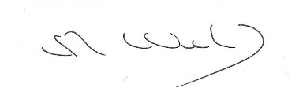

FOREWORD
The Association of Chief Trading Standards Officers (ACTSO) created the Impacts and Outcomes Framework in 2018/19 to provide national data for England and Wales on work done by local authority Trading Standards Services. The purpose of this third specific report of its kind is to highlight the collective impact of Trading Standards Services in Wales during 2022/23.
During 2022/23, the cost of living crisis continued to impact both consumers and businesses. As such the need for effective business advice and fair competition remains very important for businesses. Consumers looking for bargains remain at risk from unsafe, illicit, and fake goods as well as false claims relating to prices and energy costs, in particular. Trading Standards are vital to addressing all those risks whilst also having a key role in local authority net zero programmes.
As well as the usual three themes of Tackling Detriment and Preventing Harm, Supporting the Local Economy, and Promoting Health and Wellbeing, we have devoted specific sections to environmental regulation and work to support consumers and businesses with the cost of living crisis.
While Local Trading Standards Services remain stretched in terms of funding and staffing, they continue to have a big impact in protecting consumers and helping businesses. The headlines from this year’s report for Wales are:
Trading Standards obtained almost £2.8 million scams related redress for consumers. This has stayed the same more or less since 2021/22. With local authorities looking at alternatives to formal Court actions, this often results in agreements to pay redress. The potential introduction of conditional and discretionary cautions may well assist in this respect.
The amount of money saved for scam victims was almost £3 million, an increase of £0.5 million on last year which shows the prevalence of scams with high financial losses to vulnerable individuals.
Trading Standards provided over 1,300 hours of advice to businesses through Primary Authority partnerships to 75 businesses. This is similar to the figures for last year. The total number of Primary Authority partnerships also increased by 7% from last year. Advice to businesses outside of Primary Authority Partnerships remained similar to pre-pandemic levels.
Over 11,000 compliance checks were carried out to ensure businesses meet their legal responsibilities and to provide them with advice on site. This is similar to last year’s levels.
In summary, most activity levels are recovering to pre-pandemic levels. Trading Standards continued to demonstrate its huge value in protecting consumers, legitimate businesses, public health, and the environment.
The impact of this work, alongside that which is delivered via National Trading Standards, highlights the results that Trading Standards achieves. Trading Standards is unique in having an infrastructure that can operate at local, regional, and national levels in this way and this is key to its success.
We want this report to inform both the Welsh Government and Westminster’s policy development, including funding for services, and to raise the profile of Trading Standards’ work within local authorities.
Nearly £10 million of detriment was prevented by Trading Standards’ actions.
Revenue budgets were just over £11 million, a similar figure to last year which translates to a cut in real terms, particularly when consideration is given to current inflationary trends.
Overall staff numbers have dropped from 2021/22’s figure of 257. There remains an ageing workforce and recruitment challenges are being faced across the country. This has been highlighted to the Welsh Government via the Directors of Public Protection Wales’s report ‘Public Protection Services in Wales - Building for the Future’. The Regulatory Apprenticeship discussion is also progressing with Welsh Government, and it is hoped that this will assist in future workforce planning for Trading Standards.
The demand on the service, measured by the number of referrals from Citizens Advice, 24,838, decreased by 40% from 2021/22 when it was abnormally high at 34,587 following the pandemic, bringing it back to pre-2020/21 levels.
This year 70 people or businesses were convicted of offences. This is slightly down on last year when 87 people or businesses were convicted of offences. This is likely to be caused by resource constraints at local authority level, a focus on more serious cases, and delays and complexity within the justice system.
Judith Parry
Chair – Trading Standards Wales and Association of Chief Trading Standards Officers Welsh Representative
Richard Webb
Chair of the Association of Chief Trading Standards Officers

Slide 3

BACKGROUND AND METHODOLOGY
Local authorities in Wales were asked to submit data for the financial year 2022/23. The indicators measure demand and resourcing alongside key outputs and outcomes from Trading Standards’ activity.
Seventeen services contributed, covering 19 trading standards services based serving a total of 22 local authorities in Wales. The responses cover an area with a population of 2.7 million, or 87% of the population of Wales.
To illustrate the estimated national impact of Trading Standards, figures have been adjusted to account for both population and the response rate for each question. The resultant figures estimate impact and activity levels for the whole of Wales.
DEMAND AND RESOURCING
The approximate revenue budget allocated to Trading Standards was just over £11 million, a similar figure to that reported for 2021/22 but a cut in real terms when rapidly increasing inflation is taken into account.
Approximately 227 full time employees are employed on Trading Standards’ work. This was not dissimilar to last year. Of those, 88% are “operational” staff.
Trading Standards received over 33,000 referrals and notifications to their services from various sources. Whilst down significantly on last year, it has to be taken into account that throughout the pandemic there were a whole range of issues that affected consumers, such as travel refunds, which no longer feature in the statistics. This demonstrates how many members of the public are seeking advice and support from Trading Standards on consumer related problems and issues.

Slide 4
SECTION ONE: TACKLING DETRIMENT AND PREVENTING HARM
The Government’s 2022 Consumer Protection Study estimated that there was £54 billion in unaddressed detriment across Great Britain. One of the key functions of Trading Standards is to prevent consumer and business detriment and tackle the criminal behaviour that leads to it and support victims.
Trading Standards’ work can include providing advice and support to the public on how to avoid being victimised, as well as disrupting and taking enforcement action against criminal behaviour, to prevent harm and financial detriment. The former may be limited due to the financial constraints faced by local services and the need to focus on statutory activity.
1.1 Stopping Fraudulent, Illegal and Unfair Trading
As a last resort, Trading Standards Services do have to take formal enforcement action. This is usually where people deliberately break the law, have caused serious harm, or have repeatedly ignored advice from officers. Trading Standards legislation carries a variety of penalties including prison; fines; forfeiture of assets; fixed penalties; and undertakings to stop future non-compliance. Serious investigations are complex, lengthy and can take several years to bring to trial. This is being exacerbated by ongoing serious backlogs in the Court system. Government is now legislating for more use of improvement and compliance notices by Trading Standards, although this currently only applies to limited elements of the regulatory framework enforced.
Last year,
70 defendants were prosecuted and convicted.
Prison sentences of over 19 years were handed down.
Defendants were ordered to pay almost £67,000 in fines and over £45,000 in costs.
Defendants were ordered to pay almost £4,000 in Proceeds of Crime.
The use of Enterprise Act undertakings, which can only be used for a narrow set of Trading Standards work, remains very low with only 2 being implemented.
1.2 Detriment and Redress
Trading Standards can ask for the Court to issue a compensation order for victims as part of a prosecution process or get redress for victims through a variety of other means. In .2022/23, it is estimated that the actions of Trading Standards Services resulted in:
Over £64,500 compensation being awarded to victims by the courts.
Over £596,000 prevented from being handed over to criminals.
Over £206,000 was gained for victims through advice and intervention.
Compensation via other processes increased by 17%. Other levels were similar to last year.
Overall Trading Standards actions prevented almost £10 million of detriment to consumers and businesses, more than 3 times greater than last year.
This shows that Trading Standards continues to provide a low cost but very important service for local communities and individuals, and demonstrates the seriousness of the offending being tackled by the service.

Slide 5

1.3 Supporting Scam Victims
Recent reports show that fraud remains one of the most widespread crimes in the UK. Trading Standards identify and support victims of scams, especially the most vulnerable and often elderly victims of fraud. With so many pressures on household budgets, it has been increasingly vital that hard pressed consumers do not lose any of their money to scammers and fraudsters.
Trading Standards help victims get the support they need to stop them responding to scams. This includes the installation of call blocking devices, work with other safeguarding agencies, and making referrals to the National Trading Standards Scam and E Crime Teams to undertake disruption work such as getting payment systems removed or taking down content from the internet.
However, it must be recognised that most scams emanate from overseas and thus, in practice, are out of reach of Trading Standards enforcement.
In 2022/23, it is estimated that across Wales:
Local authority Trading Standards provided support to almost 1,300 scam victims.
Work to disrupt mass marketing fraud mailings, stop outgoing payments, mail etc saved consumers almost £2.75 million.
While the number of scam victims supported has reduced this year, the savings have increased. This shows that the disruption work to prevent people becoming victims in the first place crucial.
Pembrokeshire County Council: Prosecution of rogue used car dealer
Pembrokeshire Trading Standards took a successful prosecution against a used car dealer, resulting in a suspended sentence. The dealer advertised vehicles on the roadside and via social media whilst claiming to be a private seller; at times also advertising via friends’ Facebook profiles. Over a two-year period, 43 advertisements were collected as evidence by Trading Standards. Cars were often bought for scrap value and sold soon after without necessary repair work being carried out. One car was bought for £330 and sold the next day in the same condition for £950. Two vehicles were in a dangerous and unsafe condition. Victims included an elderly man and a teenager. Fraudulent claims were also made about the condition and length of remaining MOTs.
Rhondda Cynon Taf – Young Friends against Scams initiative
Rhondda Cynon Taf Trading Standards have commenced working with both English and Welsh medium schools to deliver the Young Friends training. Feedback from the pilot school was very positive in respect of the theme and materials provided. The teacher stated, 'The PowerPoint prompted great discussion with my year 6 pupils and they were all very engaged in the topic. I linked it to our current theme of 'enterprise' where the pupils have been learning about handling money and budgets, and prioritising spending. The scams lesson was a perfect fit and it allowed us to achieve some of our wellbeing (PSE) skills'. Pupil feedback included: 'I enjoyed the lesson; it helped me understand more about scamming and I can help explain things to my parents' and 'I learned that I need to be careful on random websites'.

Slide 6
Newport City Council: Friends Against Scams
Since September 2022, 13 Friends Against Scams talks have been delivered, the majority in partnership with Age Cymru. 94 members of the public have attended. It is estimated that the combined detriment saved because of equipping them with the requisite scam avoidance information is £5,452.00. In addition, 56 visits have been made to scam victims identified by NTSST referrals. The combined estimated detriment saved is calculated to be £3,248.00.
Blaenau Gwent County Borough Council: Preventative Doorstep Crime work
Blaenau Gwent’s Trading Standards Service places a high priority on protecting the borough’s most vulnerable residents. The service operates a Doorstep Crime Rapid Response Protocol in conjunction with Gwent Police which ensures that as soon as a complaint is received of an incident, a Police and Trading Standards Officer attend the incident immediately, investigate the complaint and provide any further support required. The service has also set up 5 No Cold Calling Zones in Blaenau Gwent in areas that have been identified as being a target by rogue traders in the past. When victims of traders are identified and appear vulnerable, often repeat victim’s referrals are made to the Authority’s Community Safety Section and security measures are put in place by means of a referral to Care and Repair and Gwent Police.
City and County of Swansea: Prosecution of rogue roofer
In September 2019, Swansea Trading Standards received a complaint in relation to poor roofing work carried out by a roofing company based in Carmarthenshire. This was the start of 17 complaints in total from consumers across South Wales regarding roofing work which was either unnecessary or of very poor standard, and in the majority of cases, unfinished. On investigating these complaints, Swansea Trading Standards identified one individual who was linked to all of the complaints. That individual tried to evade detection by continually changing his company name, business address and contact numbers including providing false names for himself.
In total, these consumers paid £182,067.88 – which consisted of £104,062 originally paid to the individual, followed by £78,005.89 in rectification work to a genuine third party.
Sentencing, Judge Timothy Petts told the defendant “You left 17 victims in a state of extreme distress and the impact on their lives and homes cannot be underestimated. You fleeced them of hundreds and thousands of pounds and the work required to put it right will cost tens of thousand pounds more.”
The individual concerned was sentenced to 5 years in prison (minus 130 days whilst spent on tag), a Criminal Behaviour Order was granted to prevent him from participating in this line of business again until such time as he applies to the Court to have it removed.
Blaenau Gwent County Borough Council: Rogue Traders targeting the vulnerable
Rogue traders carrying out roofing repair work targeted a number of elderly residents in two Blaenau Gwent towns, charging extortionate prices for repairs. Most residents have been targeted previously and the householders’ details, in all probability, passed on. All residents were visited and details taken of the traders involved for further criminal investigation purposes which included Trading Standards contact with the trader in question along with the submission of the intelligence relating to each incident onto the National Trading Standards Intelligence database which allows for regional criminal investigation work targeting organised rogue trader criminal groups.
Additionally, all householders targeted were referred by Trading Standards to the Community Safety Team for a further referral to Care and Repair for the installation of relevant target hardening support packages (security measures) at each address.

Slide 7
SECTION TWO: SUPPORTING THE LOCAL ECONOMY
Trading Standards helps businesses to comply with the laws designed to ensure that they trade fairly and that their products are safe. This year, as businesses have faced significant inflationary impacts and some sectors are still feeling the aftermath of the pandemic, the ability to access the correct advice and have confidence that they are not being undercut by unscrupulous competitors who are willing to break the law has never been more important.
2.1 Businesses Get the Help and Support they need to Thrive and Grow
Having a thriving local business community is a key priority for all local authorities. Trading Standards role in providing advice and support to businesses has never been more important.
Trading Standards Services provided over 1,300 hours of advice to businesses via Primary Authority Partnerships. 75 businesses are covered by Primary Authority Partnerships.
In 2022/23, it is estimated that across Wales::
· Over 1,300 hours were provided by Trading Standards advising Primary Authority businesses
· Trading Standards responded to almost 1,500 requests for advice from businesses that were not part of the Primary Authority scheme. This is similar to pre-pandemic levels.
2.2 Creating and Maintaining a Level Playing Field for Safe and Fair Competition
In any economy, fair competition is crucial for businesses. Being undercut by those who do not meet proper standards and regulations will cause legitimate businesses to fail, putting people out of work and causing risks for workers and consumers.
Trading Standards Services follow an intelligence-led model where action is taken according to risk. This can include providing advice, seizing counterfeit, illicit, and unsafe products, or taking formal enforcement action.
Compliance visits have increased significantly from 2021/22 when 2,500 such visits were undertaken and are moving back towards pre-pandemic levels.
In 2022/23, it is estimated that across Wales:
Over 11,000 visits were carried out to businesses to ensure they comply with the law and provide advice to help them fix any non-compliance..
Over 3,600 businesses were subject to an intervention, such as advice, investigation, or referral.
59% of Trading Standards services operate an assured trader scheme to help increase consumer confidence. These tend to be targeted at specific trade sectors.
Over 12,300 counterfeit products with a market value of over £217,000, which breach the intellectual property of legitimate businesses, were seized.
Seizures of counterfeit goods reduced by nearly 50% from 2021/22. The trade in counterfeit goods damages legitimate businesses who manufacture, distribute, and buy licences to sell legitimate products. Often counterfeiting is run by international organised criminal gangs who use the profits from sales to fund other criminal activity. Therefore, it should not be regarded as a victimless crime.

Slide 8
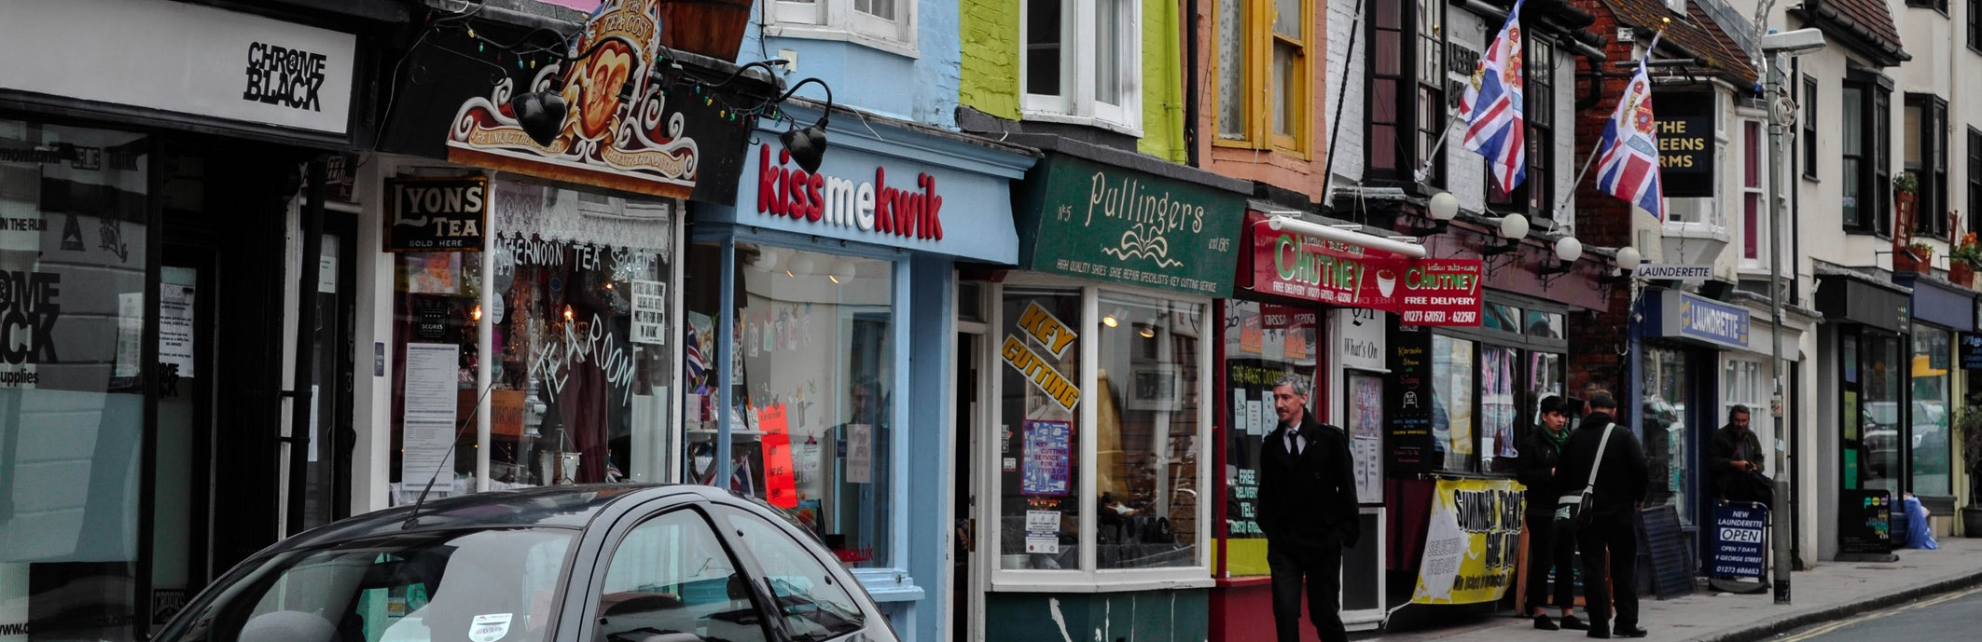
Blaenau Gwent County Borough Council: Provision of support via its Partnership Group
Blaenau Gwent Trading Standards regularly participates in quarterly "Blaenau Gwent Partnership Group" Meetings take place which bring together support services for new businesses such as Business Innovation and Regeneration Officers, financial support such as Investment Banking partners, Community Banks, local universities, Federation of Small Businesses and many more.
Organised by the Council’s Business and Innovation Team, the sessions link organisations who aim to assist and support new and growing businesses. Trading Standards participation in this group helps to ensure that new businesses receiving support from any of the organisations can also be referred to obtain advice from Trading Standards and other regulators at an early stage. This helps to avoid wasted effort and spending by the business on, for example, incorrect labels or production of non-compliant products.
In addition to the meetings, the Council’s Regeneration Team regularly support businesses with grant funding and Trading Standards links with the team to ensure that grant funding is not provided to non-compliant/rogue businesses.
Caerphilly County Borough Council: Strategic and Business Support Plans
At the heart of the Trading Standards Strategic Plan is the protection of residents and support of local businesses. This is achieved by providing a comprehensive service to both consumers in the form of Consumer Advice in response to referrals from the Citizens Advice Consumer Service (CACS), if necessary, followed up by interventions, and also, just as importantly, to businesses. Caerphilly’s Trading Standards Service doesn't wait for businesses to contact them for advice, but actively engage with them face to face. It has a risk-based programme of active support for businesses, with greater priority given to new businesses and smaller enterprises who have greater need and assistance. The Business Support Plan is formulated through both strategic and tactical planning, with regular reviews throughout the year, to be able to divert resource and offer support where needed. 99% of businesses receiving support and advice were satisfied with the service provided; quotes included; " The officer was very helpful and provided information that was easy to understand and explained really well. She also gave us a further training course and the course has been completed by my staff who found it very informative. Thank you for making it a pleasant experience", "Enjoyed the visit, gave us lots of information and some constructive advice" and " This was our first visit from Trading Standards. The officer was very supportive and took time to go through everything, informing us how to get support if needed". Feedback from business is used to review our service plan and also to shape future planning. The process is concentrated on helping business get things right first time, for their benefit and that of consumers. The savings are unquantifiable.

Slide 9
Isle of Anglesey Council: working with Holyhead Port and other partner agencies to control the importation of illegal products
Trading Standards services have concentrated on vapes due to the number of illegal and non-compliant vapes available on the market. These goods have a potential to be unsafe and have an unknown health detriment.
Coupled with the ongoing work in the vape sector – working relationships are being created with colleagues at UK Border Force (UKBF) in Holyhead to look at products coming into the UK to ascertain if unsafe and illegal products can be prevented from entering.
Port authorities, such as Anglesey, have a unique opportunity to support not only the local economy of where they are based but that of the UK as a whole, in relation to the importation of non-compliant goods and placing them on the UK market.
Following EU exit, Anglesey Trading Standards has increased spot checks in relation to the importation of goods and has forged stronger links with partners such as UKBF and Special Branch who have permanent teams located at the port and also the associated Inland Border Facility.
Despite being the second largest roll on roll off (RORO) port in the UK, after Dover, accounting for 1.4m tonnes of accompanied freight in 2021; Holyhead has always been regarded as low risk nationally due to most imports originating from Ireland and not requiring import declarations.
Checks on manifest data are unreliable as most consignments are listed as groupage and illicit goods are often mis-declared on the manifest. Intelligence would suggest that new trade routes have been developed, with an increase in consignments being imported to Holyhead via Dublin, which originated from China/Netherlands. Between January and March 2023, 2 consignments consisting of a total of 231,920 non-compliant disposable nicotine inhaling devices (vapes), with a recommended retail price of £2.3m, were seized from the Port/Inland Border Facility by Anglesey Trading Standards, having originally been stopped by UKBF and found to be declared as cakes and atomisers. All devices had tank capacities in excess of the maximum 2ml permitted in the UK, had not been notified to MHRA and had non-compliant labelling. Despite their value, both consignments were abandoned by the importers and have subsequently been sent for destruction. Such action, to remove from circulation and destruct the product, from the point of entry, not only disrupts the illicit trade but prevents re-importation elsewhere and their supply at retail throughout the UK, although the importer’s willingness to abandon valuable cargo would suggest that it is regarded as an acceptable consequential loss and that it is still commercially viable to continue with this illegal trade.

Slide 10
SECTION THREE: PROMOTING HEALTH AND WELLBEING
Trading Standards undertake a wide range of activities to protect and promote the health and wellbeing of local communities. This includes ensuring consumer products meet safety standards, food is correctly labelled and animal health and welfare standards are maintained.
Stopping the supply of age restricted products, such as vaping products, tobacco, alcohol, and knives, are a key priority in many local authorities. Trading Standards enforce and advise on a very wide range of age restricted sales legislation to help to keep young people safe.
3.1 Ensuring the Safety of Consumer Products
Legislation and product standards are designed to ensure that products are safe and do not cause injuries or fires. Unsafe toys, electrical goods, make-up, and other products can cause serious problems and even risk lives. Trading Standards use intelligence to detect and seize unsafe products at both ports of entry and on sale within Wales.
This year the number of items removed from the market has increased by 52% and, as such, is returning to pre-pandemic levels.
In 2022/23, it is estimated that across Wales:
Nearly 22,500 unsafe or non-compliant products were seized or removed from the market place following Trading Standards’ interventions.
The savings to society, in terms of product value and injuries and fires prevented, is over £835,000.
3.2 Protecting the food chain
Food inflation has been at record levels. This can result in adulterated or falsely labelled food where unscrupulous businesses seek to get an unfair competitive advantage. Consumers need to be able to trust what they eat and get good value for money. The substitution of cheap, sub-standard ingredients, undeclared allergens and misdescribed food, all damage health and cause consumer detriment.
In 2022/23, it is estimated that across Wales:
Over 1,500 businesses were identified as supplying food that was misdescribed, did not correctly declare allergens, contained toxic or illegal components, or was involved in food fraud. This was not dissimilar to last year.
Ensuring animal health and welfare has a key role in protecting the rural economy and helps protect the quality of the food chain.
In 2022/23, it is estimated that across Wales:
Over 850 businesses were found to be in breach of animal health and welfare legislation.
This is slightly down from 1,100 last year primarily due to incidences of avian flu last year.

Slide 11
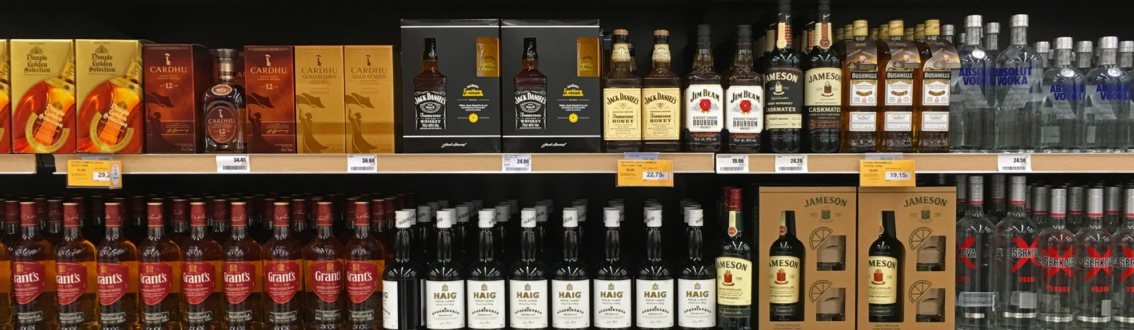
3.3 Reducing the risk of children accessing age restricted products
Trading Standards Services provide training and advice to businesses and conduct test purchases to ensure businesses do not sell age restricted goods to children. Rules that prevent children from buying age restricted products, such as vaping products, alcohol, tobacco, knives, and fireworks are designed to protect them and their local communities from both immediate and long-term harm. This year there has been a significant national focus on the problems caused by the sale of vaping products to children.
In 2022/23, across Wales:
128 premises were tested for alcohol sales.
The average failure rate for alcohol test purchases was 16.4%.
20 premises were tested for tobacco sales.
The average failure rate for tobacco test purchases was 15%
216 premises were tested for other products, including fireworks, gambling and knives.
The average failure rate for other products was 24%.
297 test purchases were made in relation to e-cigarettes
The average failure rate in relation to e-cigarettes was 23%
There has been a significant increase in the test-purchasing of “other” products. This is primarily due to the test-purchasing of vaping products but also includes fireworks, gambling and knives. Initial data suggests there were at least 258,000 disposable vaping products seized with over 600 voluntarily surrendered.
3.4 Reducing the availability of illicit products
Illicit tobacco, vaping products and alcohol can contain undeclared contaminants.
The presence of illicit tobacco in local shops undermines Government’s attempts to help people to cut down and quit smoking altogether as price is a critical factor in pushing people to give up. Illicit tobacco is significantly cheaper to buy, with packs of cigarettes being between half and a third of the price of legitimate products.
The amount of tobacco seized is similar to last year and much of the work is due to the investment HMRC has made into National Trading Standards, who commission local authorities to carry out activities to disrupt the local supply of illicit tobacco. Much of this activity is focussed on using detection dogs and can result in large scale seizures.
In 2022/23, across Wales:
1,412,527 illicit cigarettes were seized
201.1kg of illicit hand-rolling tobacco was seized
The combined illegal street value of these seizures is worth an estimated £385,307.75 whilst their legal value amounts to £1,005,930.20
100 premises were tested for sales of illegal tobacco product, the failure rate was a staggering 88%
The Licensing Act 2003 allows for a review, and potential removal of a licence, by a local authority Licensing Committee, where failures to comply with any of the four licensing objectives occur. These objectives are preventing crime and disorder, public safety, the prevention of public nuisance and the protection of children from harm. Activities by Trading Standards across Wales have not resulted in any Licence Reviews being carried out.

Slide 12

  Isle of Anglesey Council: tackling vapes at the border
  In addition to the interventions at Holyhead Port and the Inland Border Facility, resulting in the destruction of 231,920 disposable vapes with a recommended retail price of £2.3m referred to in Section Two of this report, there has been significant work undertaken by Anglesey Trading Standards in relation to the accessibility of school children to nicotine inhaling devices.
  Concerns were raised by secondary schools and Social Services on Anglesey in March 2023 in relation to the huge increase in school children that were vaping. The Education Service implemented a strict zero tolerance with any school child found vaping on school property being suspended. During the same period intelligence was received that some specific retailers in Holyhead were selling illegal vapes to children. Anglesey Trading Standards visited 48 businesses which sold vapes, targeting premises in proximity of the secondary schools, providing advice and guidance on age restricted sales, the Challenge 25 policy and identification of illicit vapes which were illegal for the UK market. Businesses were also sent letters reminding them of their obligations to prevent underage sales and advised that test purchasing would be undertaken by Anglesey Trading Standards. In early April 2023, 27 test purchases were undertaken resulting in 1 sale. Intelligence was also received that school children with links to local retailers were selling to classmates, which was referred back to Social Services as a safeguarding matter as potential child exploitation. Arrangements were made in March 2023 for those shops identified by means of intelligence to be visited in early April 2023, as a result of which 2,335 illegal disposable vapes worth a total recommended
  retail price of £29,000 were waivered by 2 retailers in Holyhead. Anglesey Trading Standards also facilitated a collaborative project between the Isle of Anglesey County Council, ASH Wales and Public Health Wales to gather evidence in relation to the vaping habits of school children, to steer future government proposals and legislation.
  Newport City Council: use of Account Freezing Orders in relation to the sale of illegal tobacco
  Newport City Council investigated a shop selling illicit tobacco that resulted in a criminal prosecution. The owner of the shop was subsequently found to be working in another shop, in a different local authority. This shop had been purchased from the Newport defendant and was found to be selling illicit tobacco. The new owner of the shop was prosecuted by the local authority for the sale of illicit tobacco. Criminal funds were identified because of financial intelligence received. Newport City Council’s Accredited Financial Investigator used civil powers under the Proceeds of Crime Act to make an application to the Court for an Account Freezing Order under Section 303Z1(2) of POCA. The Account Freezing Order was for £22,435.56. A potential forfeiture application for the frozen assets may be made. This is a reliable tool to disrupt criminal activity.

Slide 13
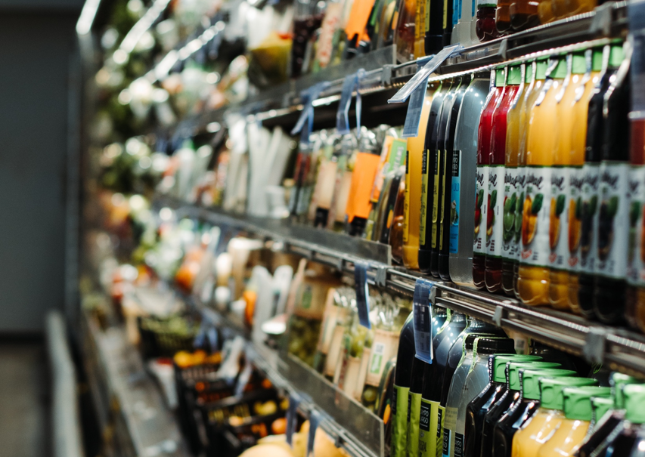
  Denbighshire County Council: fire safety in holiday accommodation
  In response to a fire incident, officers have been working in partnership with the local fire authority to address product safety concerns in a holiday let environment entailing inspections of accommodation and safety certificates and labels to ascertain the overall safety of furniture.
  North Wales Fire Service initially contacted officers as part of an ongoing investigation into a fire at a holiday venue. The fire involved a sofa bed located in a chalet and the sofa appeared to be the main seat of fire, which produced a visibly large amount of thick black smoke. Every chalet, over 800 on the site, had a similar sofa bed.
  Officers form Trading Standards and the Fire Service inspected the sofa beds to determine whether they were compliant with the Furniture & Furnishings (Fire) (Safety) Regulations 1988. Both brand new sofa beds in storage and ones in use in the chalets were examined and it was noted that the specific fire safety labelling and information as required by the regulations was available. The holiday let company provided officers with test certificates for the sofa beds but officers felt that these test certificates were unreliable as the description of the samples tested did not fully match the sofa beds inspected. Fire Service officers took a small sample of the filling
  and material from one of the sofa beds and at a later date carried out a basic ‘non-scientific’ test in which a naked flame was applied to the material and the findings were not as expected and caused some concern. Based on this information, Trading Standards officers suspected the sofa beds to be unsafe and instructed the company to urgently arrange testing of the sofa beds at a UKAS accredited test centre. Guidance on this process was given to the company. Officers further advised that whilst these tests were being conducted, the sofa beds should not be used. The company made arrangements for the testing and confirmed the sofa beds would not be used.
  The test results concluded that the sofa beds failed to comply with the Furniture & Furnishings (Fire) (Safety) Regulations 1988 (as amended), and arrangements were made to remove and destroy all sofa beds on site. A follow up visit by officers involved confirmed all sofa beds had been removed and replaced with single beds.

Slide 14

SECTION FOUR: Net Zero, Energy Costs and Climate Change
The Net Zero and Climate Change agenda continues to be important to local authorities. Many have this issue as a key corporate priority.
The cost of living crisis has also meant that claims associated with energy efficiency and costs are attractive to consumers as they look to save money.
While there is no specific data collected on this issue, figures will be included within the totals for compliance checks, business advice and prosecution figures in previous chapters. For example, Trading Standards carry out work in relation to:
Misleading claims on green energy products such as heat pumps and solar panels.
Ensuring compliance with Energy Performance Certificates and Minimum Energy Efficient Standards.
Misleading “greenwashing” claims.
Enforcement of single use plastics bans.
Blaenau Gwent County Borough Council: Energy Performance of local authority owned buildings
Trading Standards Officers inspected local authority owned buildings and provided detailed advice to Local Authority Building Managers in respect of The Energy Performance of Buildings (England and Wales) Regulations 2012 and the Energy Efficiency (Private Rented Property) (England and Wales) Regulations 2015.
Officers also entered into preparatory discussions with a neighbouring local authority in order to formulate an agreement for reciprocal enforcement arrangements required under the Regulations.

Slide 15
SECTION FIVE: COST OF LIVING CRISIS
As referenced throughout this report, the cost of living crisis has been a major influence on the work undertaken by Trading Standards this year. Similar to net zero, there is no specific data collected on this issue as figures are included within the totals for compliance checks, business advice and prosecution figures. However, the case studies below give examples of the type of work being undertaken.
Caerphilly County Borough Council: Facebook ‘friend’ grant fraud
During a visit to a sheltered housing complex, Trading Standards Officers were approached by a resident who had been contacted by a ‘friend’ on Facebook and told she was eligible to apply for a grant. Thinking she could secure some money for her family during a difficult time, she applied and was told she needed to pay about £320. The payment was made using the ‘friends and family’ option on PayPal, as the individual believed she was sending money to a friend. Realising she had been scammed, the victim complained to her bank and PayPal, but neither would help her. This was an incredibly distressing and upsetting situation for the victim, impacting on her confidence and diminishing her trust. Officers intervened and contacted PayPal, who did not properly respond to the complaint. With the victim’s permission, it was escalated to the Financial Ombudsman Service, ultimately obtaining full reimbursement.
Newport City Council: Operation Cost of Living Action
Newport Trading Standards has instigated Operation Cost of Living Action. This involves the scrutiny of Citizens Advice referrals on a weekly basis. Historically, many local authorities had dedicated consumer advice staff that would intervene in circumstances where traders appeared to be unreasonably withholding refunds, trying to change their minds using the art of persuasion in the absence of any legal powers to do so. Local authorities never had a duty to do this, but it was seen as the right thing to do and offered the potential to improve business behaviour. In recent years most Trading Standards services have had to stop interventions in civil matters due to resourcing constraints. In this case, Newport Trading Standards identified suitable civil matters where it was considered that a Service intervention may possibly secure a refund or other suitable outcome. So far, 34 referrals have been identified, with a combined detriment of £339,611.
Blaenau Gwent County Borough Council: Cross Party Cost of Living Group
In response to the cost of living crisis, Blaenau Gwent County Borough Council formed a cross party cost of living group to establish what the local authority could do, with partners, to mitigate against the impact of the crisis for the people of Blaenau Gwent. Consequently, Blaenau Gwent Trading Standards participated in a special event on the crisis in November 2022, which brought staff together from across the council for two reasons:
to share what has been done to date and what is planned in relation to the cost of living crisis for the people of Blaenau Gwent, and
to gather intelligence from staff in relation to the support they already offer to the people of Blaenau Gwent which can contribute to the council’s action plan.
The Group continues to operate, offering cost of living advice and support with links and signposting for areas such as debt advice, financial support schemes, food banks and warm hubs and Trading Standards Officers periodically distribute social media messaging in relation to cost of living scams.

