Slide 1




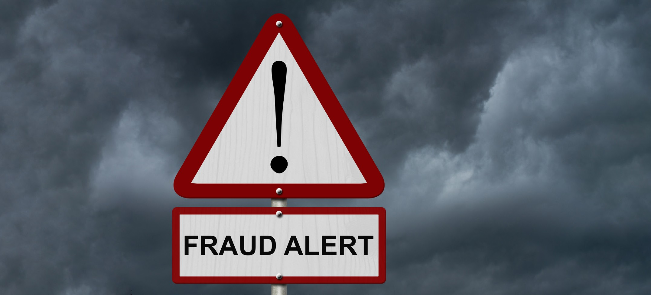
Protecting the Public and Supporting Business During the Pandemic
The Impacts and Outcomes of Local Trading Standards Services 2020/21 in England and Wales
This report is the third year that Trading Standards Services have benefitted from the Association of Chief Trading Standards Officers (ACTSO) comprehensive assessment into the value that local Trading Standards Services deliver.
This year’s report, 2020/21, coincidences with the most severe periods of the Covid 19 pandemic and can therefore assess the impact of the Covid 19 specific work carried out by Trading Standards services in addition to the usual three themes of Tackling Detriment and Preventing Harm, Supporting the Local Economy, and Promoting Health and Wellbeing. However, due to the severe impact of Covid 19 on services, the findings of this year’s report will be incomparable to any other.
This document provides a snapshot of the key findings from this year’s assessment and demonstrates Trading Standards’ continued value in focussing support on protecting and supporting the most vulnerable and local businesses through very difficult times.
In 2020/21, despite the COVID-19 pandemic, local Trading Standards Services have:
Prevented over £588 million of detriment against an approximate revenue budget of £104 million
Increased the number of scams victims supported by 26%
Increased support for businesses by 28%, including advice for new start-ups and those needing to change operations to click and collect or on-line delivery
Received almost 800,000 referrals and notifications to services, an increase of 20% compared to last year
Carried out almost 250,000 thousand Covid related visits and inspections to businesses across England and Wales
TACKLING DETRIMENT AND PREVENTING HARM
One of the key functions of Trading Standards is to prevent consumer and business detriment (financial and non-financial), tackle criminal behaviour that leads to it and support victims.
Key statistics for 2020/21 included:
Over 650 defendants taken through the prosecution process
Over £3.7 million prevented
from being handed over to criminals
Prison sentences of over 203 years handed down. This included both immediate and suspended sentences
Local authority Trading Standards
provided support to over 27,300 scam victims
Defendants were ordered to pay
over £14.2 million in Proceeds of Crime
Work to disrupt mass marketing fraud mailings, stop outgoing payments, mail etc saved consumers over £42.5 million

Slide 2
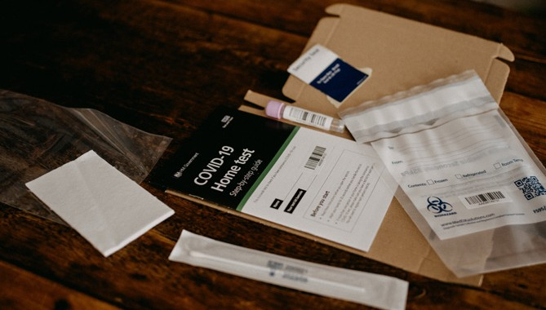
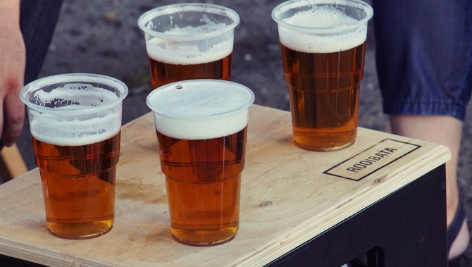













SUPPORTING THE LOCAL ECONOMY
Businesses need advice and support from Trading Standards to help them navigate the range of laws that ensure they trade fairly and safely. This was particularly crucial this year when businesses needed to respond to Covid legislation and change their businesses to survive during the pandemic.
Key statistics for 2020/21 included:
28,000 responses to requests for advice from businesses
Over 26,000 visits were carried out to businesses to ensure they comply with the law and provide advice to help them fix any non-compliance
Over 1.2 million counterfeit products were seized with a market value of £40.6 million, which breach
the intellectual property of legitimate businesses
Over 10,500 businesses were subject to an intervention, such as advice, investigation or referral
PROMOTING HEALTH AND WELLBEING
Trading Standards undertake a wide range of activities to protect and promote the health and well-being of local communities. This includes ensuring that products people buy are safe, that food is correctly and clearly labelled to help them to make healthy choices and avoid allergens.
Key statistics for 2020/21 included:
Nearly 43 million unsafe or non-compliant products and PPE were seized or removed from the market place following Trading Standards’ interventions
Over 210 premises were tested for alcohol sales, The average failure rate for alcohol test purchases was 25%
The savings to society, in terms of product value and injuries and fires prevented, is almost £330 million
Over 210 premises were tested for tobacco sales, The average failure rate for tobacco test purchases was 39%
Over 4,600 businesses were identified as supplying food that was misdescribed, did not correctly declare
allergens, contained toxic or illegal components or were involved in food fraud
Over 230 premises were tested for other products, including knives. The average failure rate for other products was 32%
Over 12.6 million illicit cigarettes were seized, worth an estimated £2.8 million
Over 7,200 businesses were found to be in breach of animal health and welfare legislation
TRADING STANDARDS SUPPORT FOR THE COVID RESPONSE
Trading Standards were a key part of the local authority Covid response, along with other colleagues in regulatory services.
Key statistics for 2020/21 included:
In England:
Over 1.2 million Covid-secure compliance checks
either by virtual inspection or written contact
Supported local authorities with over 42,000 Covid related enquiries
Dealing with almost 98,000 complaints about non-Covid secure business settings or business closure requirements
Carrying out over 48,000 visits to business
Carrying out over 220,000 visits to business

